Slide 1

Decidable Problems Concerning Context Free Languages
Theory of Computation
王轩
Wang Xuan

Slide 2
Outline
A_{CFG}
E_{CFG}
Every CFG
EQ_{CFG}
Relationship

Slide 3
Context-free languages
A_{CFG} ={<G,w>|G is a CFG that generates string w}
A_{CFG} is decidable language
Idea 1 :
  Go through all derivations. If G doesn’t generate w, this algorithm maybe never halt. Only Turing-recognizable

Slide 4
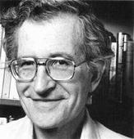


Idea 2 :
  In Chomsky normal form, any derivation of w has 2n-1 steps, where n is the length of w. Check only derivations with 2n-1 steps to determine whether G generates w would be sufficient.
Chomsky Normal Form
Chomsky

Slide 5
A_{CFG} is decidable language
Proof
S=“ on input <G,w>, where G are CFG and w is a string:
  1. Convert G to an equivalent grammar in Chomsky normal form.
  2. List all derivation with 2n-1 steps, where n is the length of w, except if n=0, then instead list all derivations with 1 step.
  3. If one of these derivations generate w, accept; if not, reject.”
A_{PDA} is decidable language

Slide 6
E_{CFG} is a decidable language
E_{CFG} ={<G>|G is a CFG and L(G) = φ}
Idea 1:
  Going through all possible w’s doesn’t work
  Idea 2:
  We need to determine whether the start variable can generate a string of terminals
    Mark all terminal symbols
    Scan all rules of the grammar, the right of production is all marked, then mark the left variable
    Continue until it cannot mark any more variables

Slide 7
E_{CFG} is a decidable language
Proof:
R=“ on input <G>, where G are CFG:
  1. Mark all terminal symbols in G.
  2. Repeat until no new variables get marked:
    Mark any variable A where G has a rule A->U₁U₂…U_{k} and each U₁,…, U_{k} has already been marked
  3. If the start variable is not marked, accept; otherwise, reject.”

Slide 8
Every context-free language is decidable
Bad idea
  Convert a PDA for a CFL A directly into a TM. Simulating a stack with TM’s tape is easy.
  However, some branches of PDA may go forever(loop). The simulating TM may also have some non-halting branches. ( not decider)
Good one:
Using the decider to decide A_{CFG}----S

Slide 9
Proof
Let G be a CFG for A and design a TM M_{G} that decides A. We build a copy of G into M_{G}.
M_{G} = “On input w:
  1. Run TM S on input <G,w>.
  2. If this machine accepts, accept; if it rejects, reject.”

Slide 10
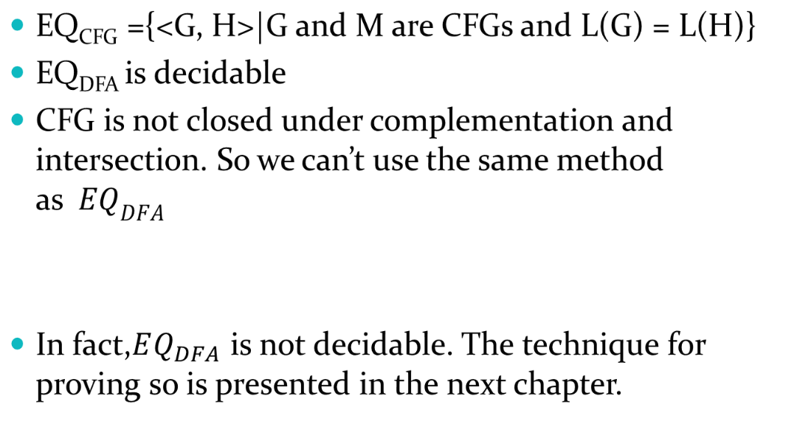
EQ_{CFG} is a not decidable

Slide 11
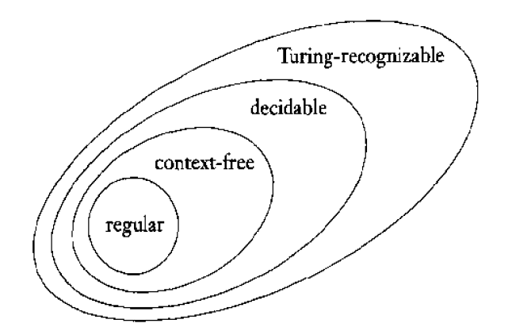
Relationship
We have learned regular, context free, decidable, and Turing-recognizable so far. The figure depicts this relationship.

Slide 12
Review
A_{CFG}
E_{CFG}
EQ_{CFG}
Every CFG
Relation

